Slide 1
Cluster Observation Analysis for Market Selection

Slide 2
Analysis Objective
Perform a Hierarchical Clustering analysis and Find 7-10 pairs of test and control markets to test a new service being developed by a National Investment brokerage firm from 20 Candidate Market Segments

Slide 3
Variables and Data Examined
Market
High Net Worth Retirees
High Net Worth Middle Aged
High Net Worth Young
FS Sent
Brand Sent
Growth Rate
Branches
Aff Branches
Market Efficiency

Slide 4
Executive Summary
From the 20 observations , 5 clusters have been formed . Cluster 1 with 3 observations
Cluster 2 with 8 observations , Cluster 3 with 1 observation , Cluster 4 with 6 observations and Cluster 5 with 2 Observations
Candidate Market Pairs Identified after doing a Hierarchical Clustering Analysis are
Atlanta and Phoenix(Alternative Houston or Chicago)
Boston and Washington DC (Alternative Raleigh)
NashVille and Seattle( Alternative Charlotte)
Los Angeles and Sacramento
Miami and Portalnd (Alternative Dallas)
Denver and Orlando (Alternative Philadelphia)
New York and San Francisco

Slide 5
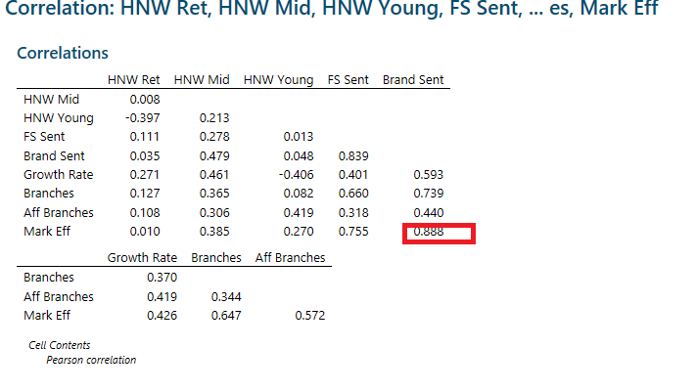
Corelations between

Slide 6
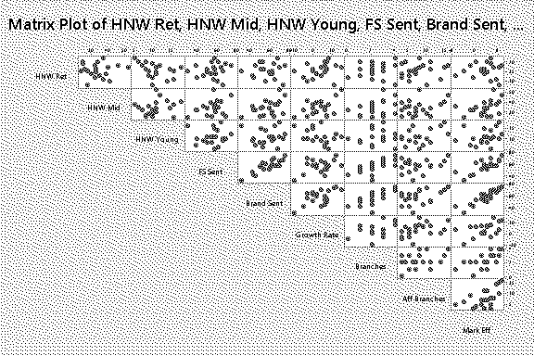
MatrixPlot

Slide 7
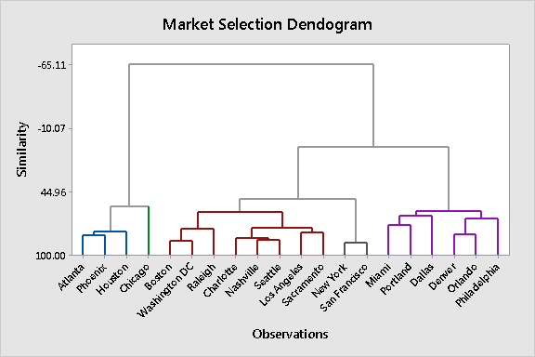
Market Selection Dendogram

Slide 8
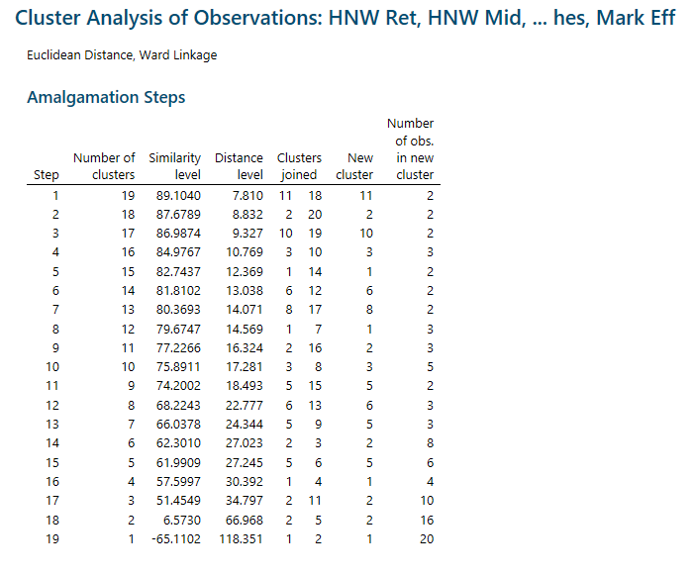
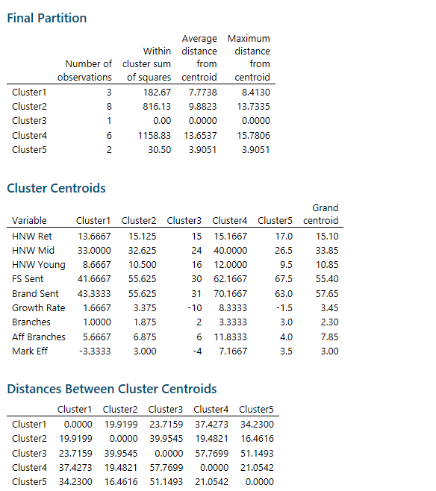

Slide 9
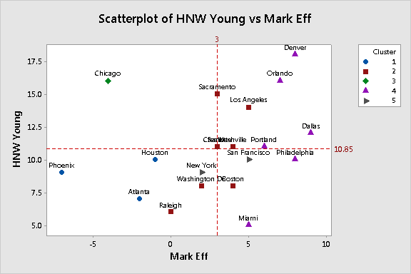
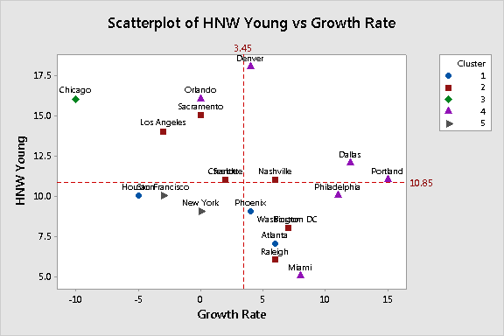
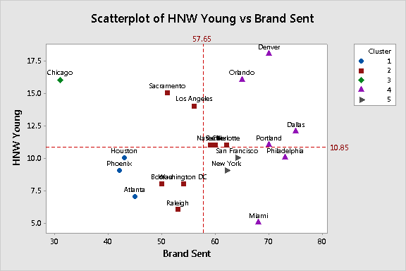
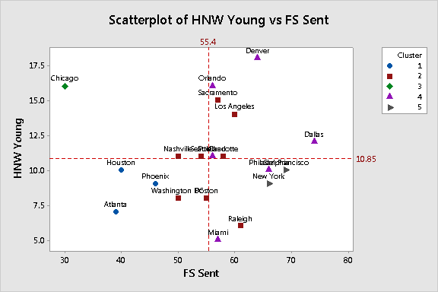

Slide 10
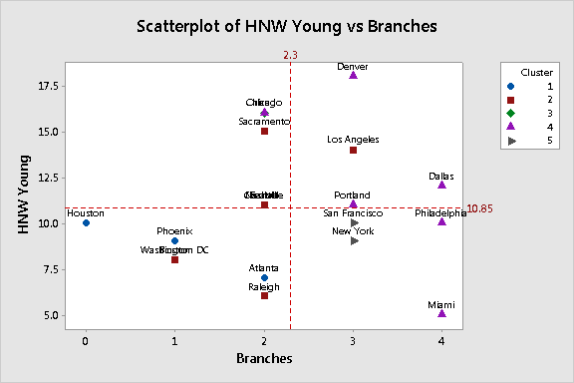
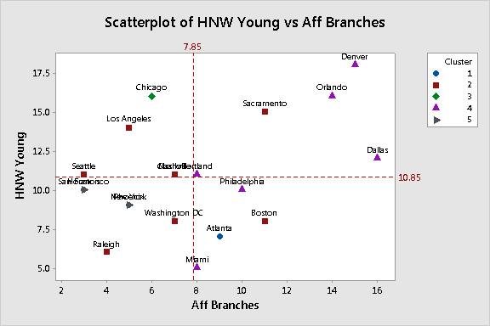
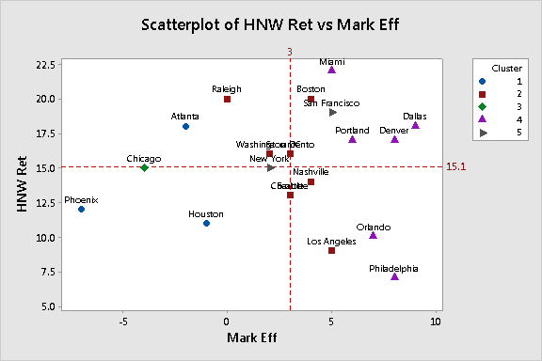
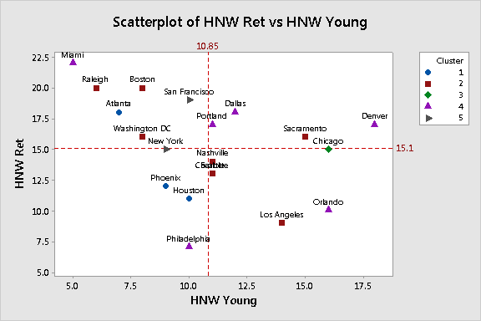

Slide 11
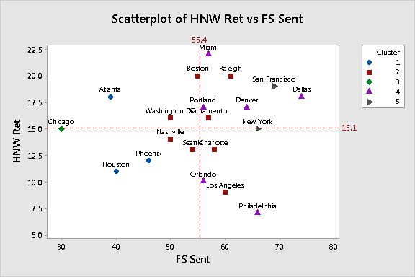
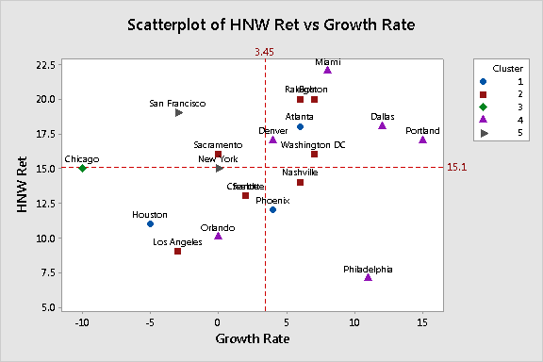
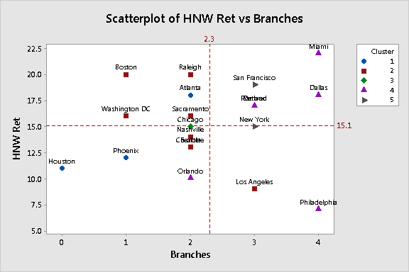
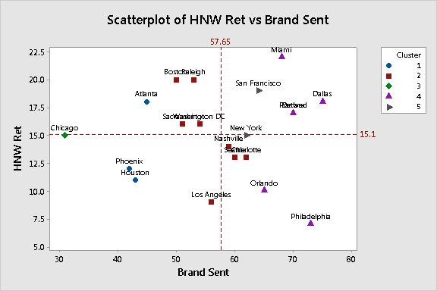

Slide 12
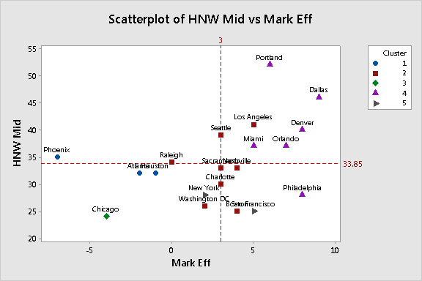
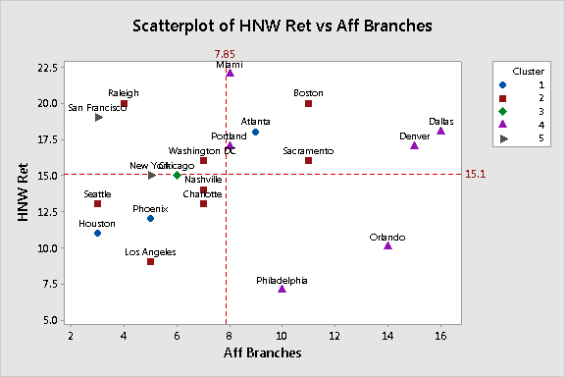
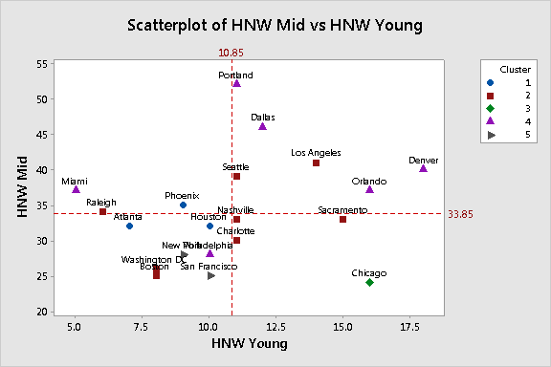
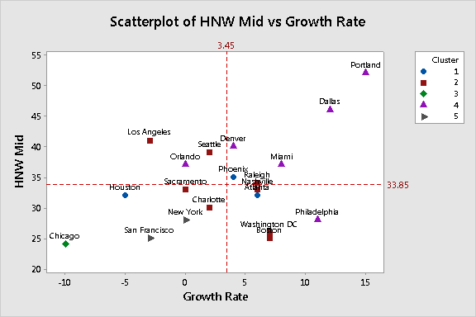

Slide 13
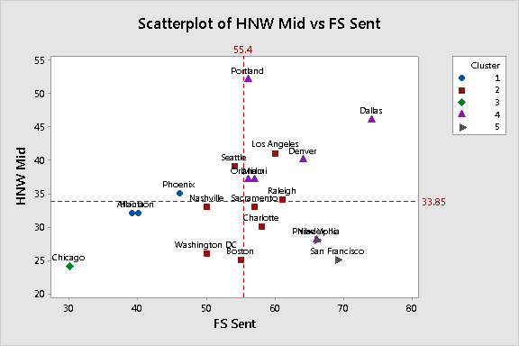
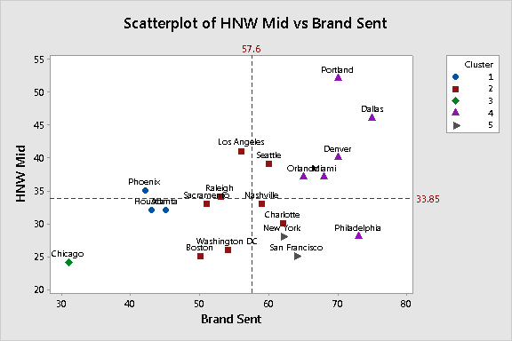
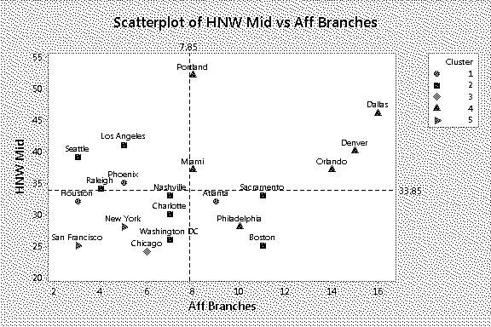
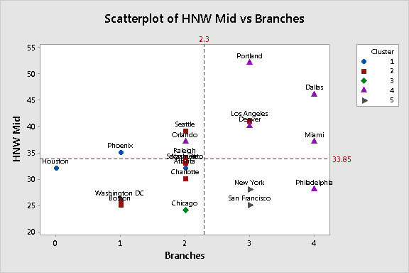

Slide 14
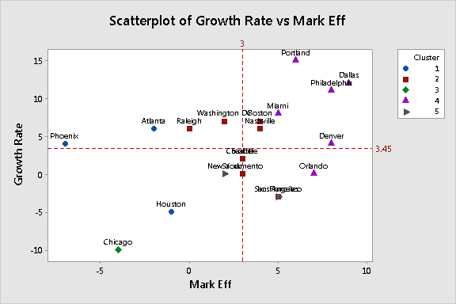
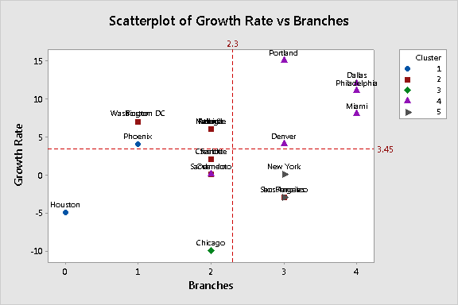
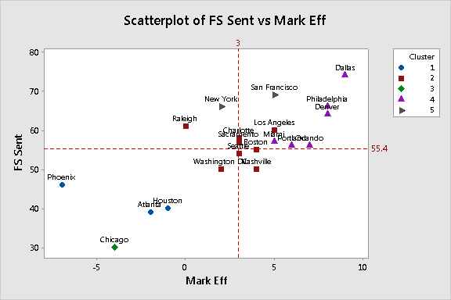
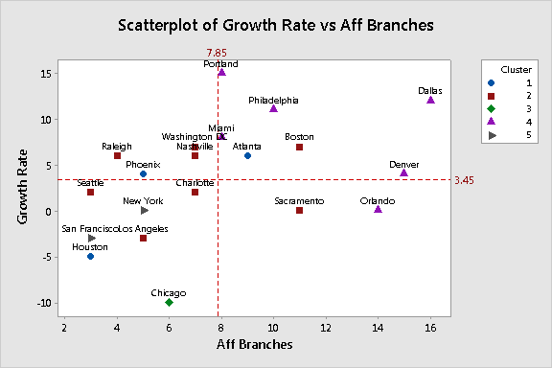

Slide 15
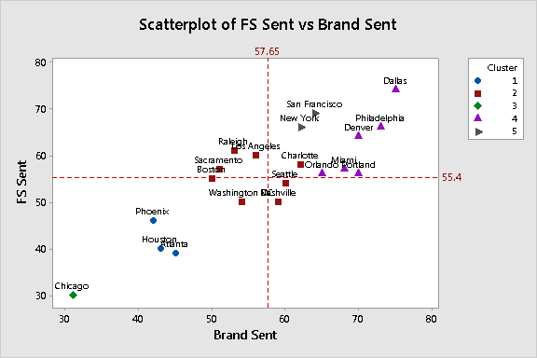
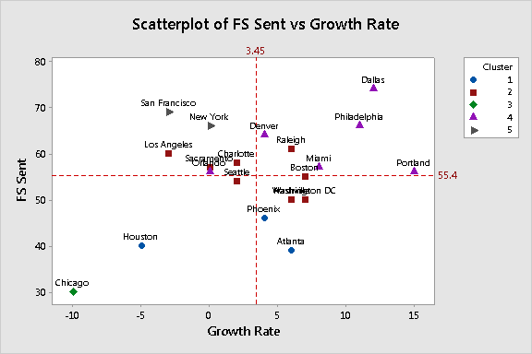
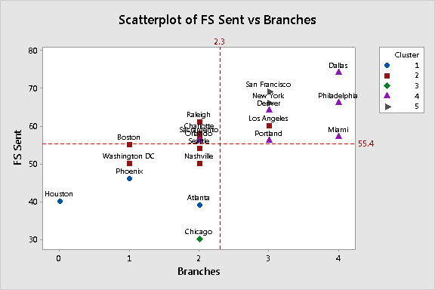
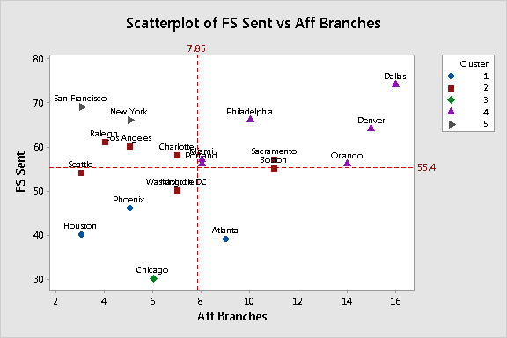

Slide 16
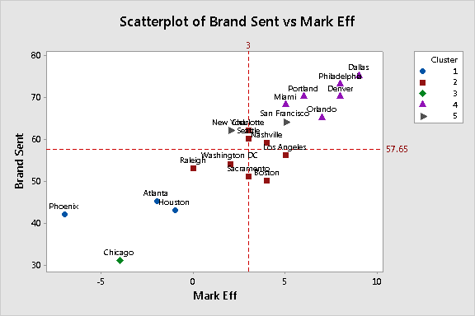
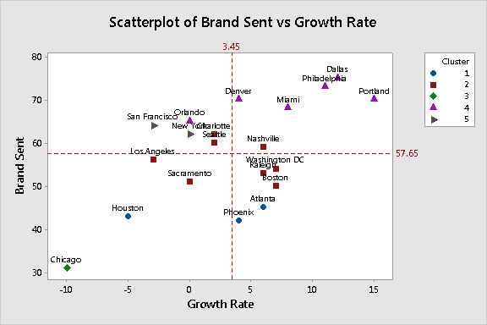
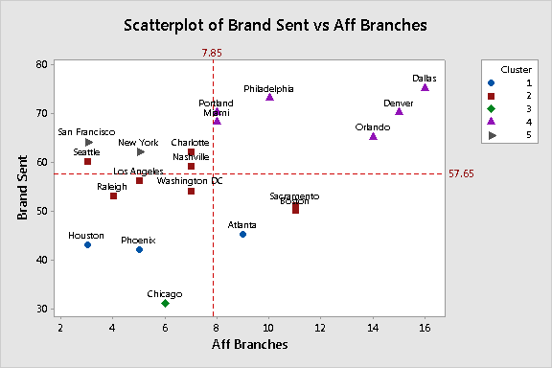
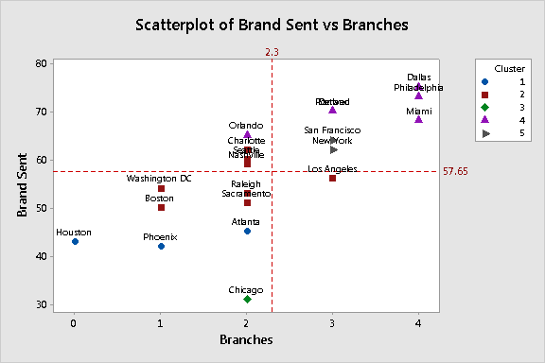

Slide 17
